Slide 1
NLP

Slide 2
Introduction to Natural Language Processing
Introduction to NLP

Slide 3
Language and Communication
Speaker
Intention (goals, shared knowledge and beliefs)
Generation (tactical)
Synthesis (text or speech)
Listener
Perception
Interpretation (syntactic, semantic, pragmatic)
Incorporation (internalization, understanding)
Both
Context (grounding)

Slide 4
Basic NLP Pipeline
(U)nderstanding and (G)eneration
(U)
Computer
(G)
Language
Language

Slide 5
Introduction to NLP
Examples of Text

Slide 6
What NLP is not about
Romeo loves Juliet.
ZZZZZ is a great stock to buy.

Slide 7
What it is about (1/2)
After the ball, in what is now called the "balcony scene", Romeo sneaks into the Capulet orchard and overhears Juliet at her window vowing her love to him in spite of her family's hatred of the Montagues.

Slide 8
What it is about (2/2)
ZZZZZ Resources (NYSE:ZZZZZ) in their third quarter financials present a picture of a company with a relatively high amount of debt versus shareholder equity, and versus revenues. The company had total liabilities in the third quarter of $4,416 million versus shareholders' equity of only $1,518 million. That is a very high 3 to 1 debt to equity ratio. The company had third quarter revenues of $306 million. On an annualized basis, revenues would come out to $1,224 million. The company's debt level is almost 3 times its annual revenues. And remember, third quarter revenue is from before oil prices dropped in half. It looks like ZZZZZ may have bitten off more than it can chew.
XXXXX Petroleum (NYSE:XXXXX) is another company whose third quarter financials present a relatively high debt load. The company had total liabilities in the third quarter of $3,272 million versus shareholder equity of only $1,520 million. That represents a high 2 to 1 debt to equity ratio. The company had third quarter revenues of $350 million. On an annualized basis revenues would come out to $1,400 million. The company's debt is more than 2 times its annual revenue. While XXXXX is a very good operator, it looks like they have taken on the high debt strategy at the wrong time.
YYYYY Energy (NYSE:YYYYY) has a relatively high debt load according to their third quarter financials. The company had total liabilities of $2,026 million versus shareholder equity of $1,079. That is almost a 2 to 1 debt to equity ratio. Their third quarter revenues were $207 million. When annualized, their third quarter revenues come out to $827 million. The company's debt is almost 2 1/2 times its annualized revenues, and that is before the collapse of oil prices in the fourth quarter. YYYYY has taken the Brigham model to heart and has been aggressively growing the company.

Slide 9
Understanding a News Story
Opposition lawmakers in Poland have been occupying parliament for three weeks in a protest against the government. Frantic efforts are now being made to end the crisis before the next plenary session on Wednesday.
Almost all of Poland's important party leaders met on Monday at the invitation of the president of the senate to try to find a solution to the parliamentary crisis. Jaroslaw Kaczynski, the head of the governing national-conservative Law and Justice Party (PiS), also took part. The PiS is clearly trying to displace the conflict to a secondary theater - the senate, Poland's upper house of parliament.
However, Grzegorz Schetyna, the head of the biggest opposition party, the PO, steered clear of what he referred to as an "absurd" meeting. He said that instead he expected the PiS speaker of the lower house to "return to the [lower house's] plenary assembly hall." After all, he said, the conflict had not begun in the senate. The leader of the other liberal opposition party, Modern, did take part in the meeting - which goes to show once again how divided the opposition is.
Over the past few weeks, Poland has been caught up in a fight between the national-conservative government and the liberal opposition. The crisis began on December 16 with the announcement by the governing PiS that they would be restricting media access to parliament. The fight escalated inside the parliament - among other things, a group of opposition representatives occupied the rostrum in the plenary chamber. The government's parliamentary party left the chamber and "passed" the 2017 budget in an adjacent room. The main bone of contention now is whether this improvised vote, by a show of hands, was legitimate or not. Ultimately, the issue at stake is whether a parliamentary party with a small absolute majority, like the PiS, has to stick to the rules, or whether it can casually set them aside.
http://www.dw.com/en/is-there-a-resolution-to-polands-parliamentary-crisis/a-37070705
Notes:
http://www.bbc.com/news/world-latin-america-28829694

Slide 10
Understanding a News Story
Opposition lawmakers in Poland have been occupying parliament for three weeks in a protest against the government. Frantic efforts are now being made to end the crisis before the next plenary session on Wednesday.
Almost all of Poland's important party leaders met on Monday at the invitation of the president of the senate to try to find a solution to the parliamentary crisis. Jaroslaw Kaczynski, the head of the governing national-conservative Law and Justice Party (PiS), also took part. The PiS is clearly trying to displace the conflict to a secondary theater - the senate, Poland's upper house of parliament.
However, Grzegorz Schetyna, the head of the biggest opposition party, the PO, steered clear of what he referred to as an "absurd" meeting. He said that instead he expected the PiS speaker of the lower house to "return to the [lower house's] plenary assembly hall." After all, he said, the conflict had not begun in the senate. The leader of the other liberal opposition party, Modern, did take part in the meeting - which goes to show once again how divided the opposition is.
Over the past few weeks, Poland has been caught up in a fight between the national-conservative government and the liberal opposition. The crisis began on December 16 with the announcement by the governing PiS that they would be restricting media access to parliament. The fight escalated inside the parliament - among other things, a group of opposition representatives occupied the rostrum in the plenary chamber. The government's parliamentary party left the chamber and "passed" the 2017 budget in an adjacent room. The main bone of contention now is whether this improvised vote, by a show of hands, was legitimate or not. Ultimately, the issue at stake is whether a parliamentary party with a small absolute majority, like the PiS, has to stick to the rules, or whether it can casually set them aside.
Why did I highlight some of the phrases above?
Notes:
http://www.bbc.com/news/world-latin-america-28829694

Slide 11
Highlighted Phrases
on Wednesday
January 11, 2017
the parliamentary crisis
What caused the crisis?
Jaroslaw Kaczyński
Former prime minister; brother of the former president
the PO
Platforma Obywatelska (Civic Platform)
he said
he = Grzegorz Schetyna
Modern
Nowoczesna (liberal political party)

Slide 12
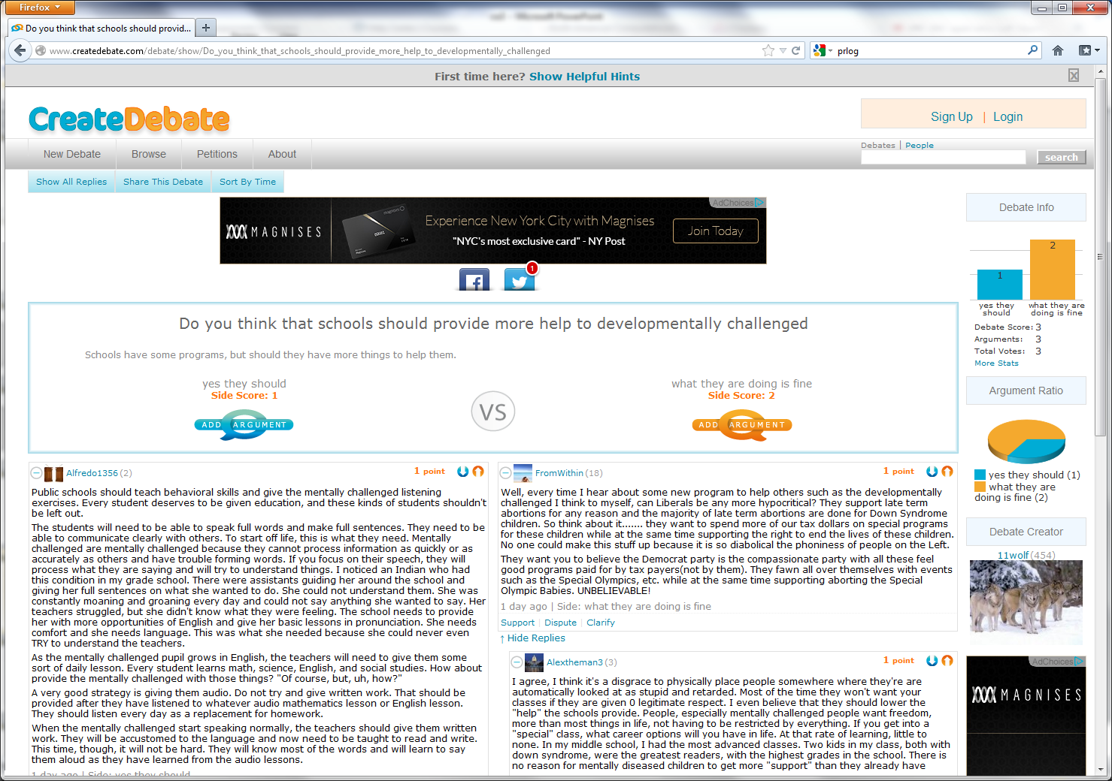
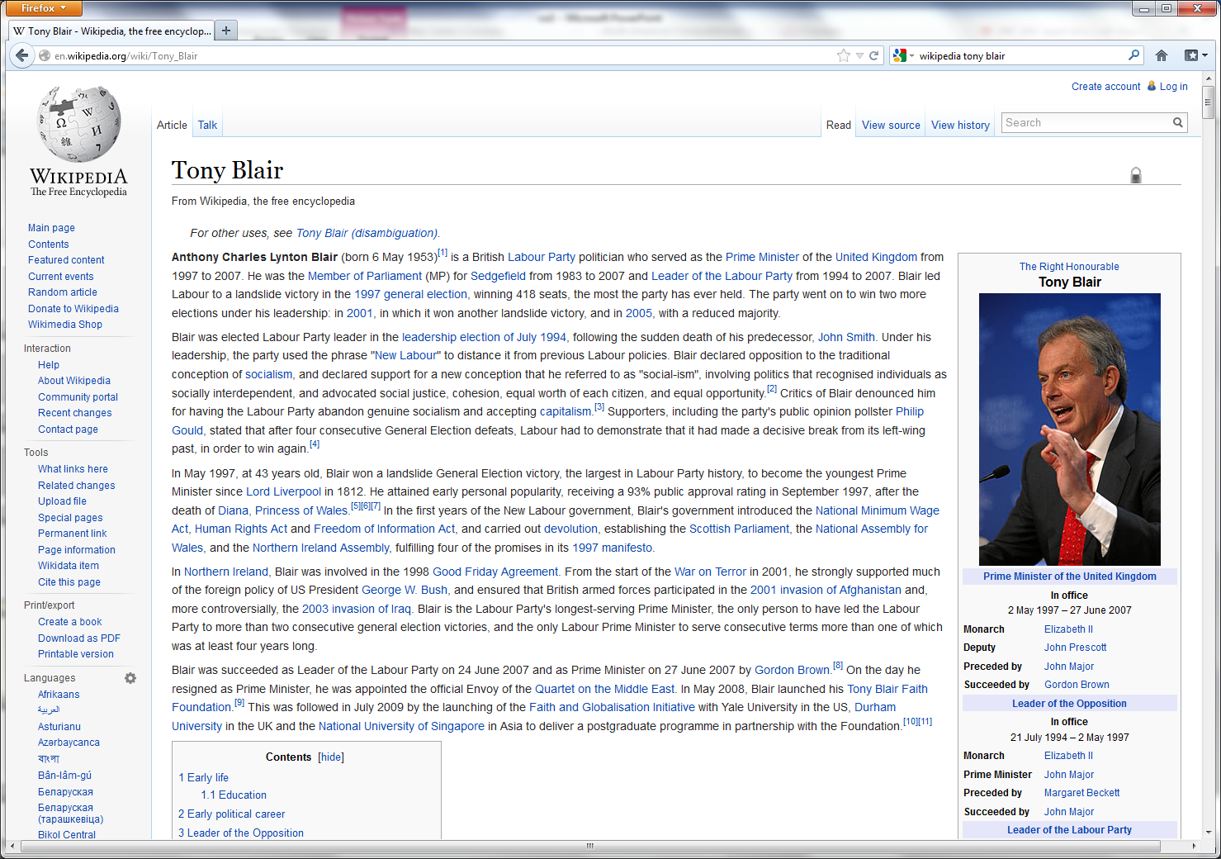
Genres of Text
Blogs, emails, press releases, chats, debates, etc.
Each presents different challenges to NLP
Notes:
Replace with other examples?

Slide 13
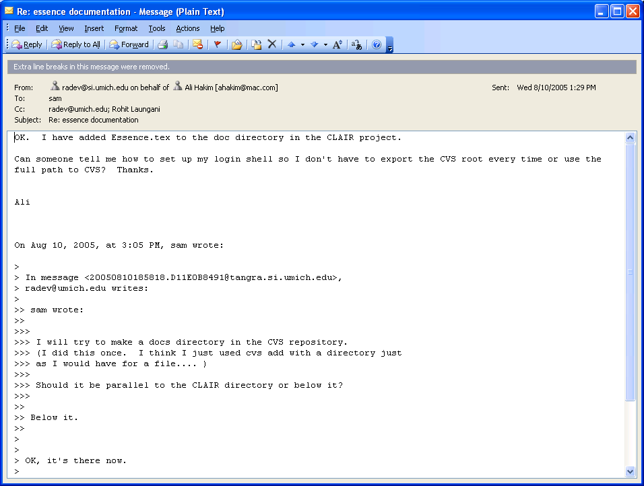
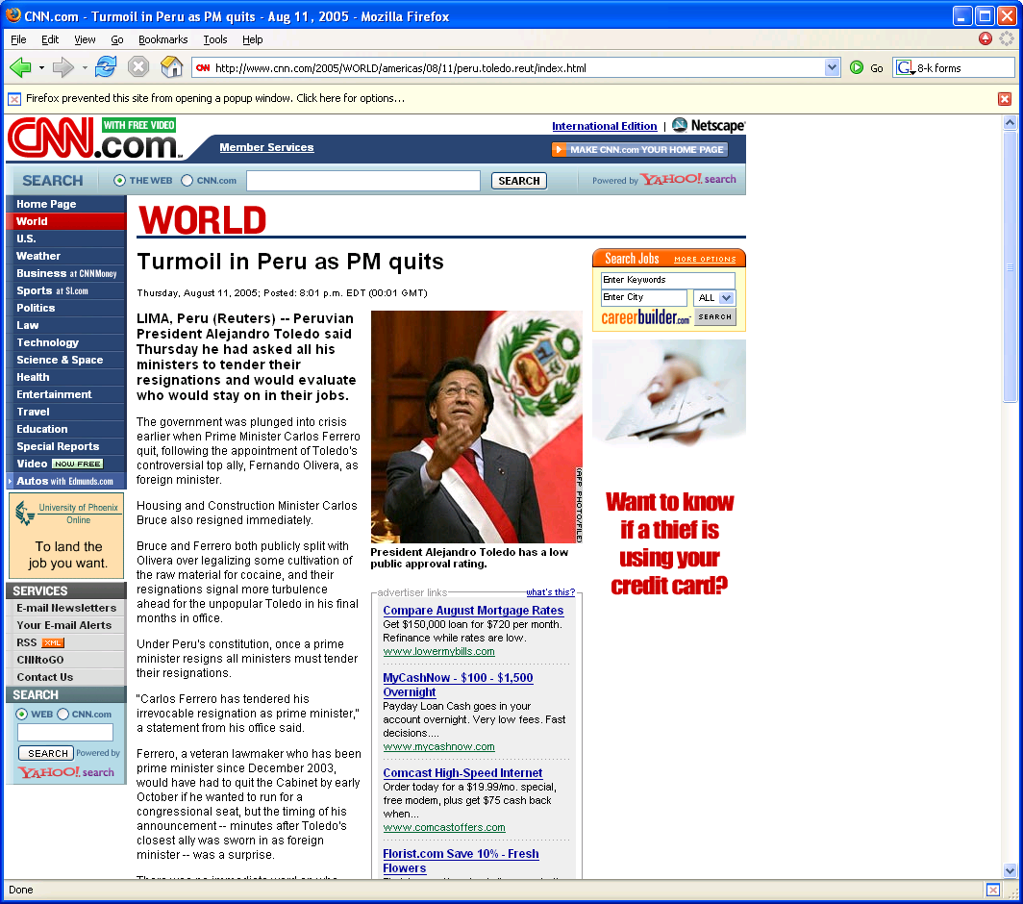
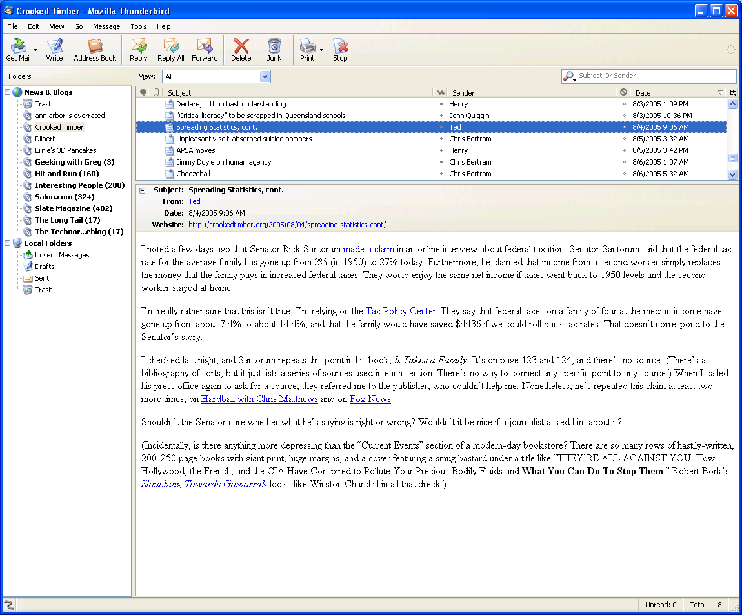
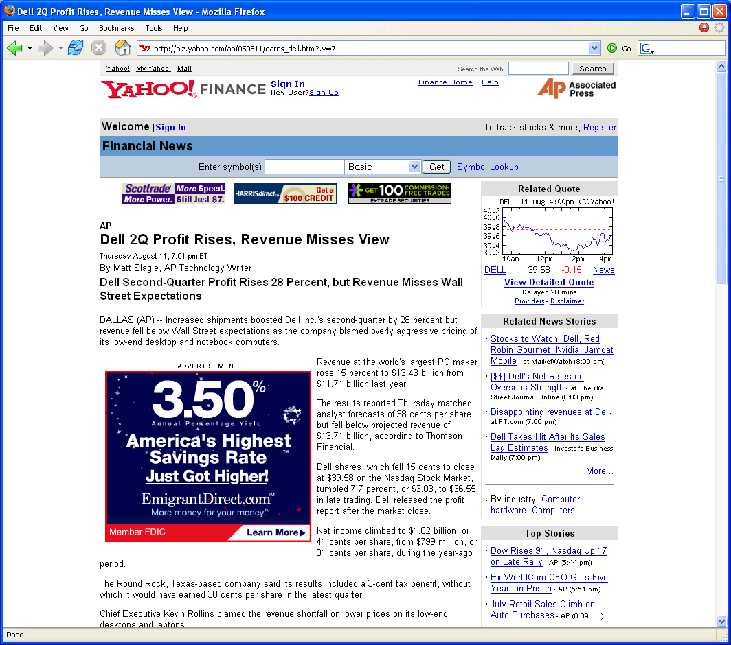

Slide 14
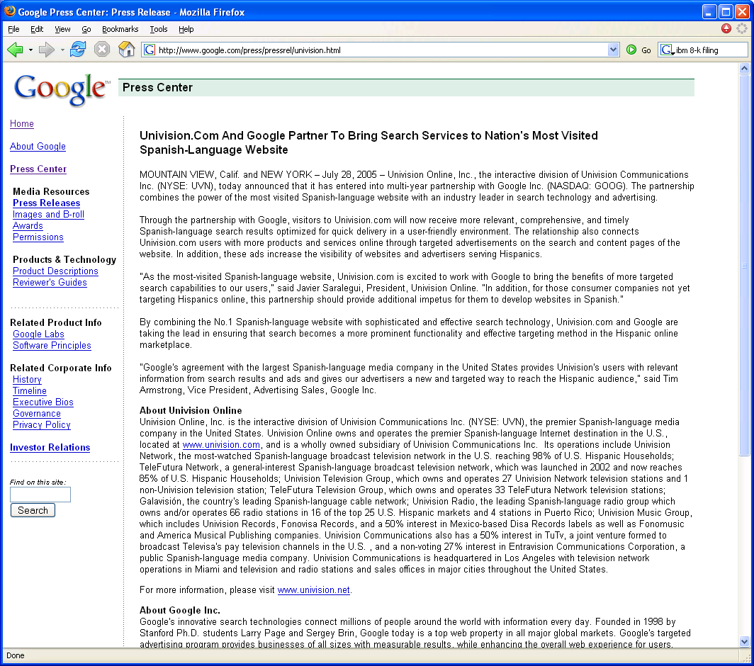

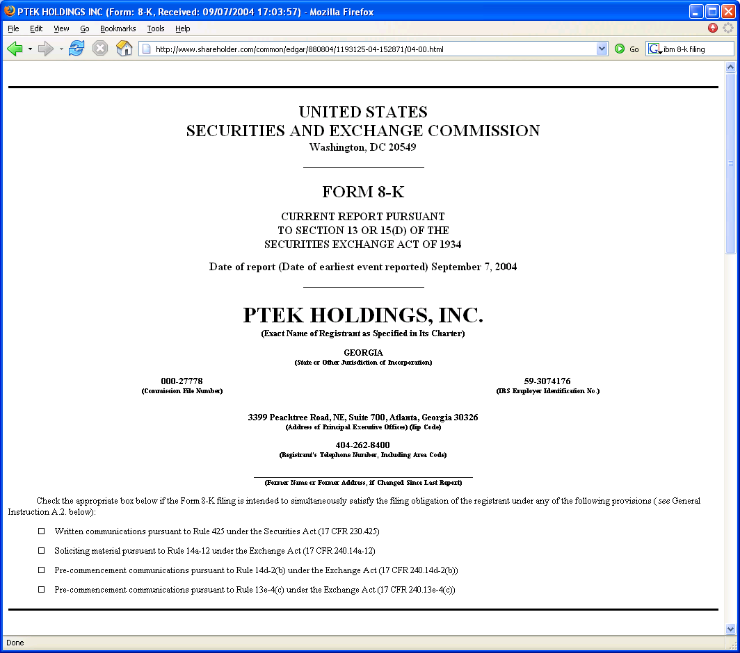
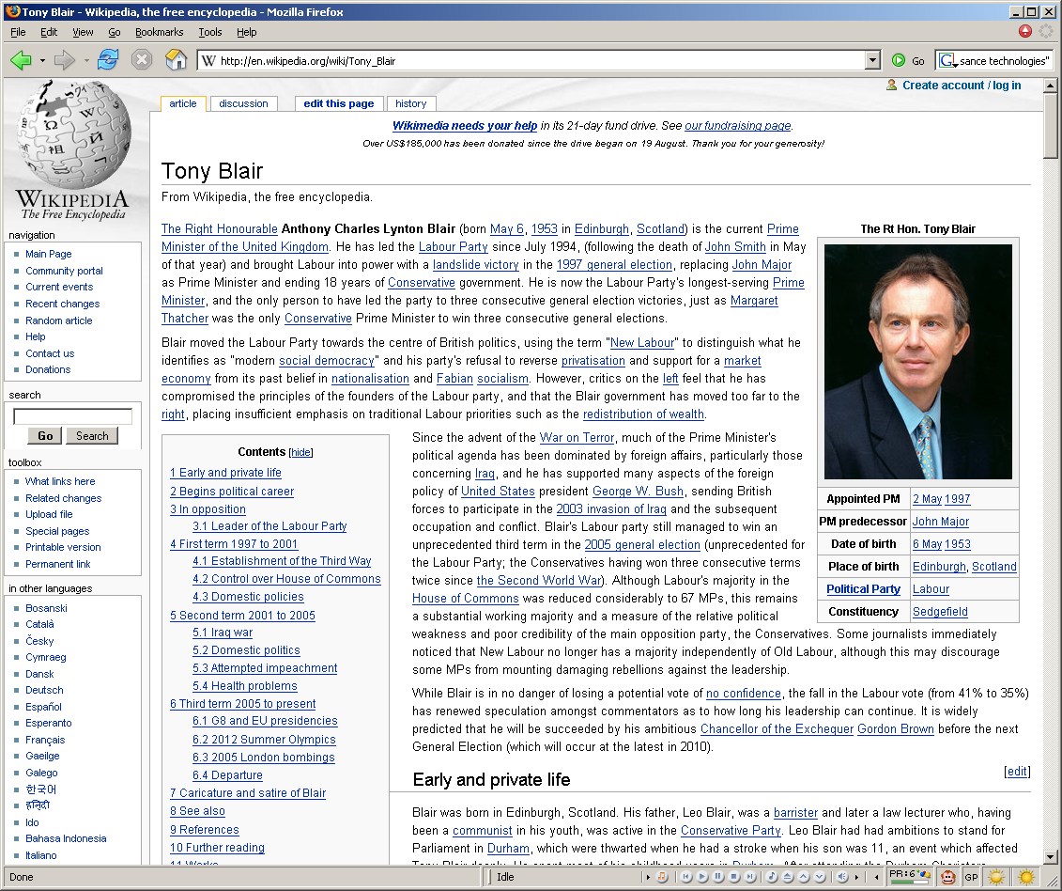

Slide 15

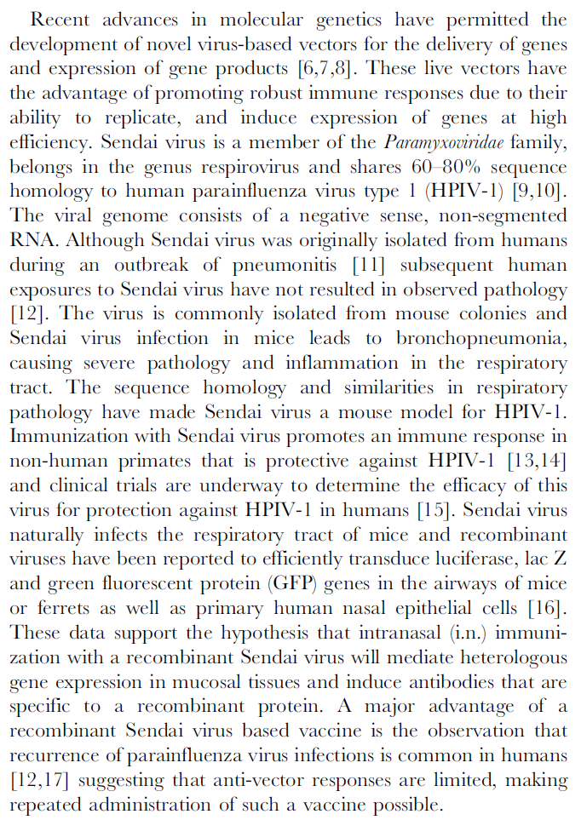
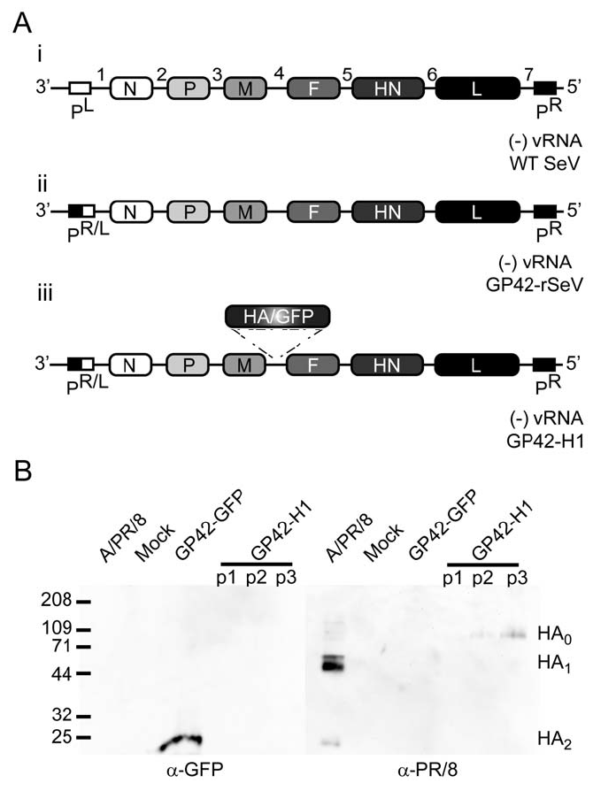

Plos ONE
DOI: 10.1371/journal.pone.0018780

Slide 16
Recent advances in molecular genetics have permitted the development of novel virus-based vectors for the delivery of genes and expression of gene products [6,7,8]. These live vectors have the advantage of promoting robust immune responses due to their ability to replicate, and induce expression of genes at high efficiency. Sendai virus is a member of the Paramyxoviridae family, belongs in the genus respirovirus and shares 60–80% sequence homology to human parainfluenza virus type 1 (HPIV-1) [9,10].
The viral genome consists of a negative sense, non-segmented RNA. Although Sendai virus was originally isolated from humans during an outbreak of pneumonitis [11] subsequent human exposures to Sendai virus have not resulted in observed pathology [12]. The virus is commonly isolated from mouse colonies and Sendai virus infection in mice leads to bronchopneumonia, causing severe pathology and inflammation in the respiratory tract. The sequence homology and similarities in respiratory pathology have made Sendai virus a mouse model for HPIV-1. Immunization with Sendai virus promotes an immune response in non-human primates that is protective against HPIV-1 [13,14] and clinical trials are underway to determine the efficacy of this virus for protection against HPIV-1 in humans [15]. Sendai virus naturally infects the respiratory tract of mice and recombinant viruses have been reported to efficiently transduce luciferase, lac Z and green fluorescent protein (GFP) genes in the airways of mice or ferrets as well as primary human nasal epithelial cells [16].
These data support the hypothesis that intranasal (i.n.) immunization with a recombinant Sendai virus will mediate heterologous gene expression in mucosal tissues and induce antibodies that are specific to a recombinant protein. A major advantage of a recombinant Sendai virus based vaccine is the observation that recurrence of parainfluenza virus infections is common in humans [12,17] suggesting that anti-vector responses are limited, making repeated administration of such a vaccine possible.
Named entities + variants (human parainfluenza virus type, HPIV-1)
Speculation (reported, suggesting)
Species (human)
Cell types (nasal epithelial cells )
Facts
References
Notes:
Surface layer
Linguistic layer
Metonymy – “The company said”
Attachment – “a year earlier”
Rhetorical/logical layer
Attribution – “according to First Call”
Pragmatic layer
Buy!?
Inferential/decision making layer
Are earning in line with analyst expectations?

Slide 17
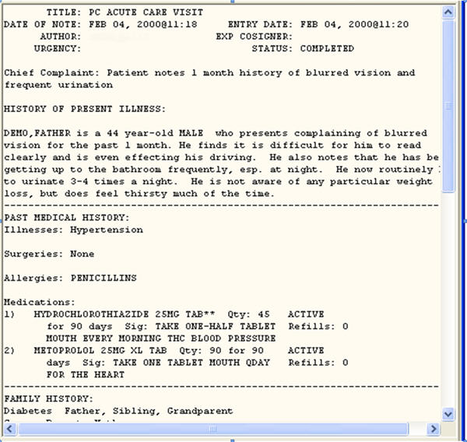
Medical Records
http://www.upassoc.org/upa_publications/jus/2009february/smelcer5.html

Slide 18
Literary Texts
Project Gutenberg (http://www.gutenberg.org/browse/scores/top)
A team of horses passed from Finglas with toiling plodding tread, dragging through the funereal silence a creaking waggon on which lay a granite block. The waggoner marching at their head saluted.
Ulysses - http://www.gutenberg.org/files/4300/4300-h/4300-h.htm
There was no possibility of taking a walk that day. We had been wandering, indeed, in the leafless shrubbery an hour in the morning; but since dinner (Mrs. Reed, when there was no company, dined early) the cold winter wind had brought with it clouds so sombre, and a rain so penetrating, that further out-door exercise was now out of the question.
Jane Eyre - http://www.gutenberg.org/files/1260/1260-h/1260-h.htm
Dorothy lived in the midst of the great Kansas prairies, with Uncle Henry, who was a farmer, and Aunt Em, who was the farmer's wife. Their house was small, for the lumber to build it had to be carried by wagon many miles. There were four walls, a floor and a roof, which made one room; and this room contained a rusty looking cookstove, a cupboard for the dishes, a table, three or four chairs, and the beds. Uncle Henry and Aunt Em had a big bed in one corner, and Dorothy a little bed in another corner. There was no garret at all, and no cellar--except a small hole dug in the ground, called a cyclone cellar, where the family could go in case one of those great whirlwinds arose, mighty enough to crush any building in its path. It was reached by a trap door in the middle of the floor, from which a ladder led down into the small, dark hole.
The Wizard of Oz - http://www.gutenberg.org/files/55/55-h/55-h.htm
Notes:
CONSIDER REMOVING

Slide 19
A Really Long Literary Sentence
Try parsing this
“Bloat is one of the co-tenants of the place, a maisonette erected last century, not far from the Chelsea Embankment, by Corydon Throsp, an acquaintance of the Rossettis' who wore hair smocks and liked to cultivate pharmaceutical plants up on the roof (a tradition young Osbie Feel has lately revived), a few of them hardy enough to survive fogs and frosts, but most returning, as fragments of peculiar alkaloids, to rooftop earth, along with manure from a trio of prize Wessex Saddleback sows quartered there by Throsp's successor, and dead leaves off many decorative trees transplanted to the roof by later tenants, and the odd unstomachable meal thrown or vomited there by this or that sensitive epicurean-all got scumbled together, eventually, by the knives of the seasons, to an impasto, feet thick, of unbelievable black topsoil in which anything could grow, not the least being bananas.“
Do you know the source?

Slide 20
Quiz Answer
“Gravity’s Rainbow” (by Thomas Pynchon), known for its use of very arcane words and complicated sentence (and plot) structure.
Another such work is “Finnegans Wake” by James Joyce.
Poetry is even more difficult.

Slide 21
Introduction to NLP
Funny Sentences

Slide 22
Silly Sentences
Children make delicious snacks
Stolen painting found by tree
I saw the Rockies flying to San Francisco
Court to try shooting defendant
Ban on nude dancing on Governor’s desk
Red tape holds up new bridges
Government head seeks arms
Cameron wins on budget, more lies ahead
Local high school dropouts cut in half
Hospitals are sued by seven foot doctors
Dead expected to rise
Miners refuse to work after death
Patient at death's door - doctors pull him through
In America a woman has a baby every 15 minutes. How does she do that?

Slide 23
Ambiguous Recommendations
Lexical ambiguity
 | For a chronically absent employee | A person like him is hard to find.
Notes:
Attribution?

Slide 24
Ambiguous Recommendations
Lexical ambiguity
 | For a chronically absent employee | A person like him is hard to find.
 | For a dishonest employee | She's an unbelievable worker.
 | For a lazy employee | You would indeed be fortunate to get this person to work for you.
 | For the office drunk | Every hour with him was a happy hour.
Notes:
Attribution?

Slide 25
Ambiguous Recommendations
Lexical ambiguity
 | For a chronically absent employee | A man like him is hard to find.
 | For a dishonest employee | She's an unbelievable worker.
 | For a lazy employee | You would indeed be fortunate to get this person to work for you.
 | For the office drunk | Every hour with him was a happy hour.
Structural ambiguity
 | For a chronically absent employee | It seemed her career was just taking off.
 | For a dishonest employee | Her true ability was deceiving.
 | For a stupid employee | I most enthusiastically recommend this candidate with no qualifications whatsoever.
 | For the office drunk | He generally found him loaded with work to do.
Scope ambiguity
 | For an employee who is not worth further consideration as a job candidate | All in all, I cannot say enough good things about this candidate or recommend her too highly.
 | For an employee who is so unproductive that the job is better left unfilled | I can assure you that no person would be better for the job.
Other
 | For a lazy employee | He could not care less about the number of hours he has to put in.
 | For an employee who is not worth further consideration as a job candidate | I would urge you to waste no time in making this candidate an offer of employment.
 | For a stupid employee | There is nothing you can teach a person like her.
From Beatrice Santorini’s collection

Slide 26
NLP

